Slide 1
Introduction to Problem Solving and Programmatic Logic
Image source: http://mitt.ca/Content/Images/uploaded/Henlow%20Campus%20-%20Exterior.jpg

Slide 2
What is Problem Solving?
From Wikipedia:
"Problem solving forms part of thinking."
"It occurs if an organism or an artificial intelligence system does not know how to proceed from a given state to a desired goal state.”
In other words:
You are “here” and want to go “there”.

Slide 3
What is Problem Solving?
Problem: I’m hungry.
Solution?
Eat your lunch.
Go to the cafe and buy some cookies.
Chew some gum.

Slide 4
What is Problem Solving?
Problem: I can’t keep track of all the DVDs I lend to people!
Solution?
Get a notebook and start keeping track of who borrows my DVDs.
Download or buy a program that keeps track of things you lend to people.
Write a program that keeps track of things you lend to people!

Slide 5
What is Problem Solving?
How does this relate to programming?
Programs can solve some problems.
When you are developing programs:
Each piece of the program is like a mini problem to solve
How do I display a report sorted by date?
How do I validate the input data?

Slide 6
What is Programming Logic?
Planning a program using various tools
Flowcharts, pseudocode
UML – Class diagrams and Use-Case
Decision Tables
Instructions
Program logic is the instructions given to the computer.
This includes how the program flows from one piece of logic to the next.
Algorithms!!

Slide 7
Introduction to Boolean Logic
Image source: http://mitt.ca/Content/Images/uploaded/Henlow%20Campus%20-%20Exterior.jpg

Slide 8
Boolean Logic
George Boole, 1840’s
Developed a mathematical system of operators and truth values
Statements that can only be true or false
Binary:
True = 1
False = 0
Creating complex statements with operators such as AND, OR, NOT, XOR, etc.

Slide 9
Examples
3 < x < 7 ???
3 is less than x (or x is greater than 3)
x is less than 7
Common sense says this is “x is greater than 3 AND x is less than 7”
3 > x > 7 ???
x is less than 3
X is greater than 7
Common sense says this is “x is less than 3 OR x is greater than 7”

Slide 10
Using Variables
In Boolean logic/algebra we simplify statements
Variables/letters and special symbols
Statements are assigned a letter
Example
Wendi prefers pudding and will eat anything covered in chocolate.
Let p = Wendi prefers pudding.
Let c = Wendi will eat anything covered in chocolate.
E.g. p AND c

Slide 11
AND Operator
Symbolism:
Λ E.g. a Λ b
* E.g. a * b
Example
I’m going to eat beans and rice for dinner
Under what conditions is this statement true?
Let b = I'm going to eat beans for dinner.
Let r = I'm going to eat rice for dinner.
Evaluate the expression b AND r (also written as b * r or b Λ r)

Slide 12
AND Operator
Truth Table:
AND
b | r | b AND r
T | T | T
T | F | F
F | T | F
F | F | F

Slide 13
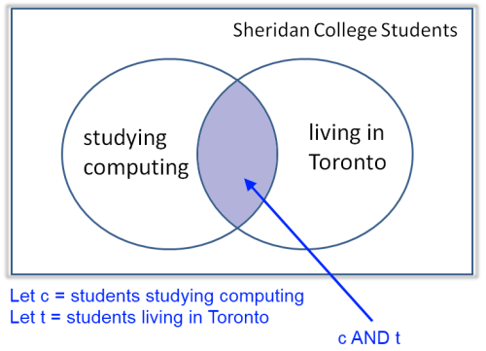
AND Operator
Venn Diagram:

Slide 14
OR Operator
Symbolism:
V E.g. a V b
+ E.g. a + b
Example
Tonight you will play World of Warcraft or do your homework.
Under what circumstances is this statement true?
Let w = You play World of Warcraft.
Let h = You do your homework.
Evaluate the expression w OR h (also written as w + h or w V h)

Slide 15
OR Operator
Truth Table:
OR
w | h | w OR h
T | T | T
T | F | T
F | T | T
F | F | F

Slide 16
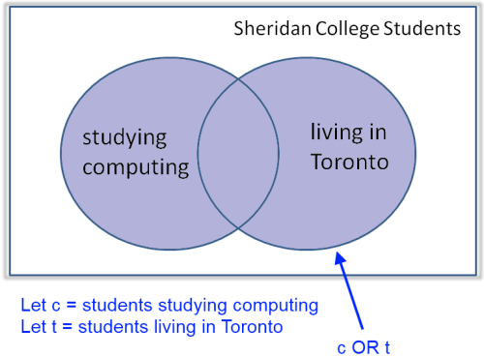
OR Operator
Venn Diagram:

Slide 17
NOT Operator
Symbolism:
~ E.g. ~b
(overline)
Example
The class is not in room g203.
Under what circumstances is this statement true?
Let c = The class is in room g203.
Evaluate the expression NOT c (also written as ~c)

Slide 18
NOT Operator
Truth Table:
NOT
c | NOT c
T | F
F | T

Slide 19
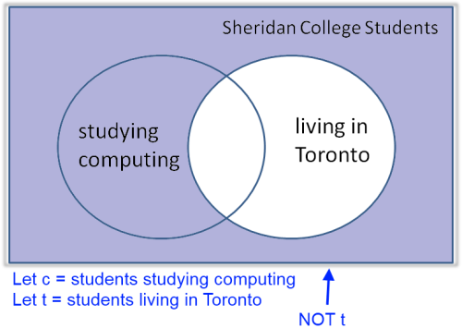
NOT Operator
Venn Diagram:

Slide 20
In-Class Exercise
Complete the in-class exercise.

